Slide 1
Clean Code
By Lars Pickelin

Slide 2
Agenda
Topic
What is clean code?
Usage
Meaningful Names
Functions
Comments
Formatting
Objects and data structures
Error Handling
Classes
Emergence
Sources

Slide 3
What is clean code?

Slide 4
Concept that leads to a „cleaner“ way of programming
Easy to learn and execute
Good:
Efficient software output
Easy to maintain
Shorter development time (in big projects).
Important fact: 80% of the lifespan from a software is for the maintenance.

Slide 5
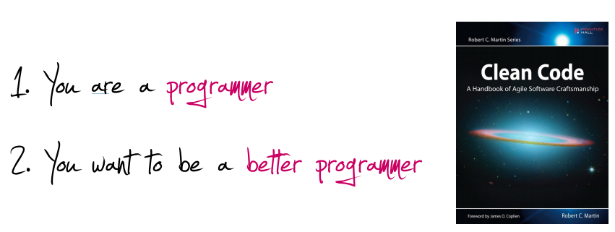
Two more reasons

Slide 6
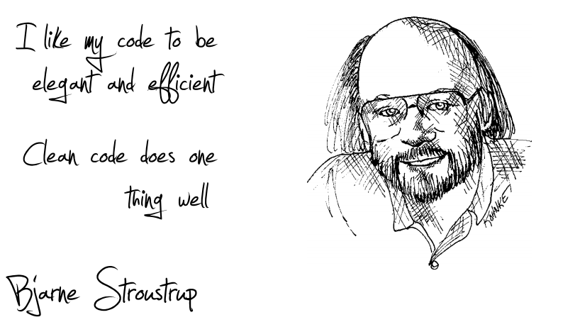
Elegance

Slide 7
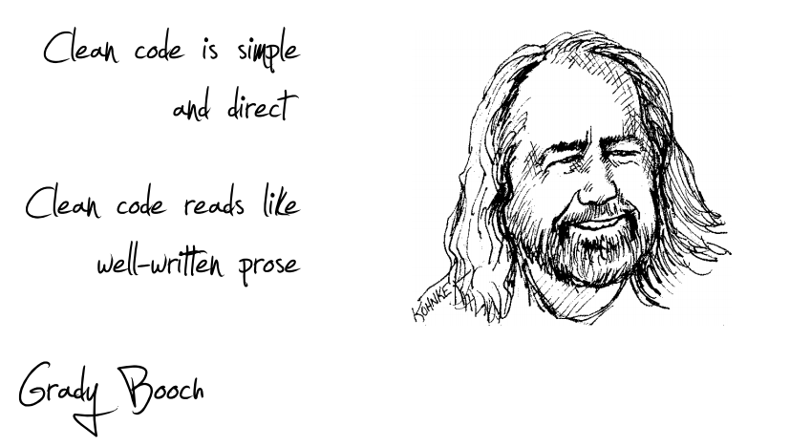
Simple, direct, prose

Slide 8
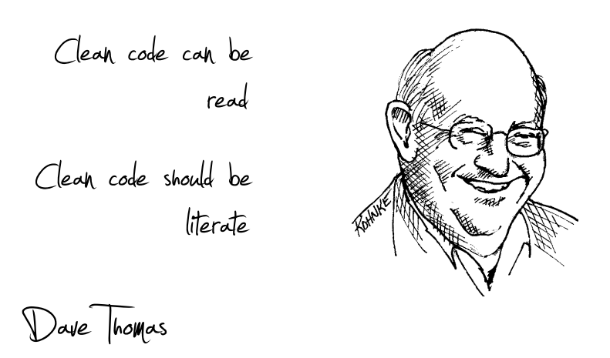
Literate

Slide 9
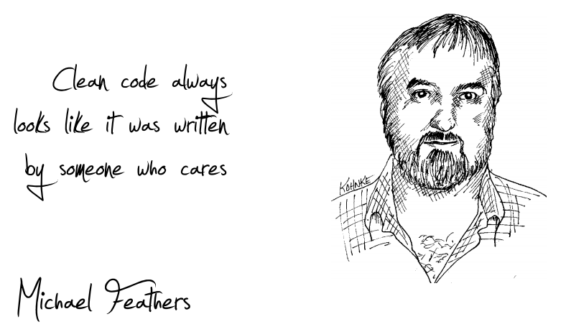
Care

Slide 10
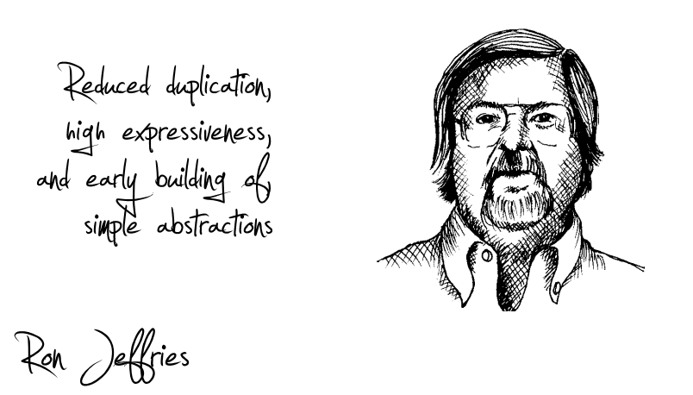
Small, expressive, simple

Slide 11
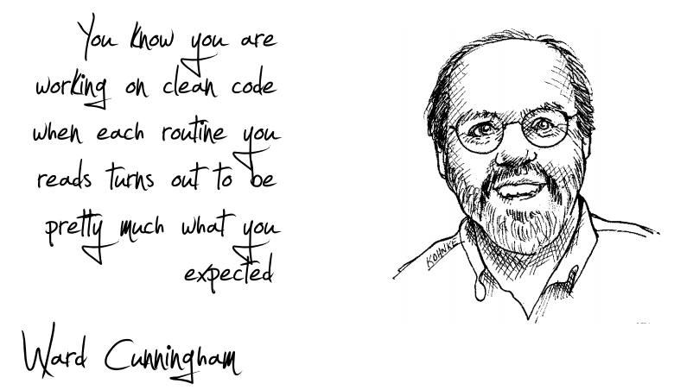
What you expected

Slide 12
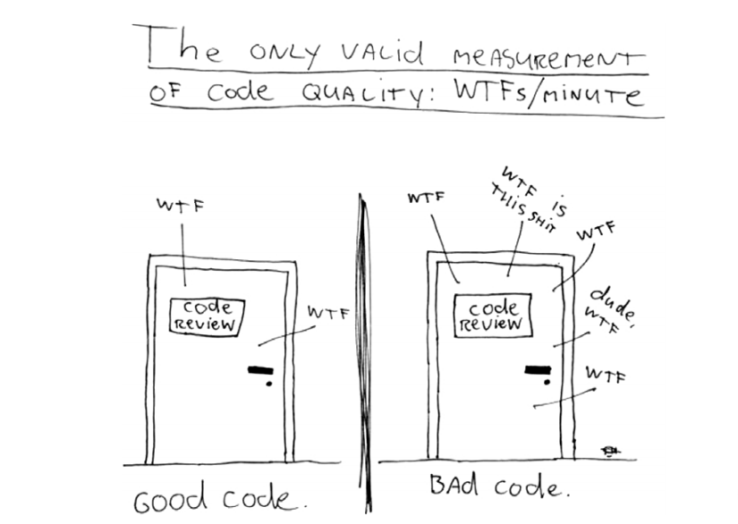

Slide 13
Usage

Slide 14
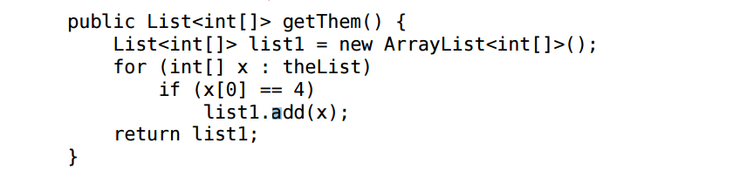
Meaningful Names - Use Intention-Revealing Names

Slide 15
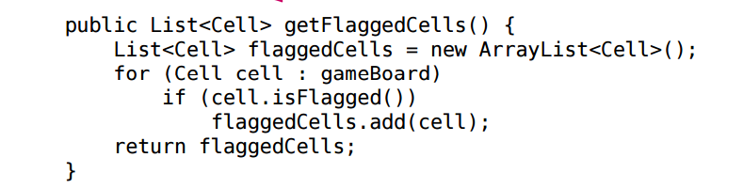

Meaningful Names – Use Intention-Revealing Names

Slide 16
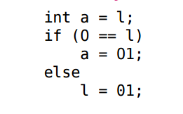
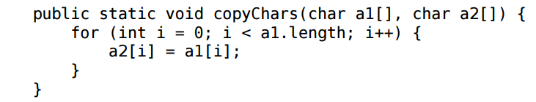
Meaningful Names
Avoid Disinformation
Make Meaningful Distinctions

Slide 17
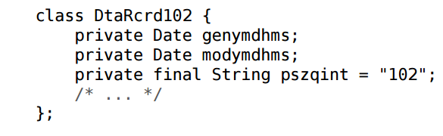
Meaningful Names
Use Pronounceable Names

Slide 18
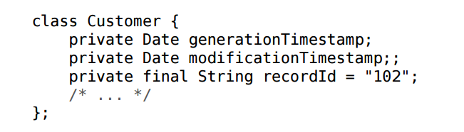
Meaningful Names
Use Pronounceable Names

Slide 19
Meaningful Names
Don’t Add Gratuitous Context
Address
// is a fine name for a class
AccountAddress, CustomerAddress
// are fine names for instances of the class Address
// but could be poor names for classes
MAC addresses, port addresses, Web addresses
// a better solution
PostalAddress, MAC, URI
Notes:
Gratuitous = Überflüssig!

Slide 20
Meaningful Names – Other important tips
Add Meaningful Contex
firstName, lastName, street, city, state, zipcode
Better: addrFirstName, addrLastName, addrState
Don’t Pun
// avoid using the same word for two purposes
Notes:
Pun = Wortspiele!

Slide 21
Functions
Small!
// rules of functions:
// 1. should be small
// 2. should be smaller than that
// < 150 characters per line
// < 20 lines
Do One Thing
// FUNCTIONS SHOULD DO ONE THING. THEY SHOULD DO IT WELL.
// THEY SHOULD DO IT ONLY.

Slide 22
Functions
One Level of Abstraction per Function
// high level of abstraction
getHtml()
// intermediate level of abstraction
String pagePathName = PathParser.render(pagePath);
Reading Code from Top to Botom
// the Stepdown Rule

Slide 23
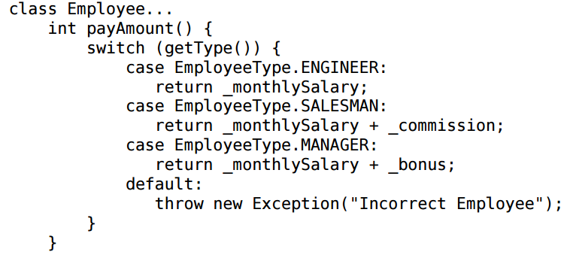
Functions
Switch Statement

Slide 24
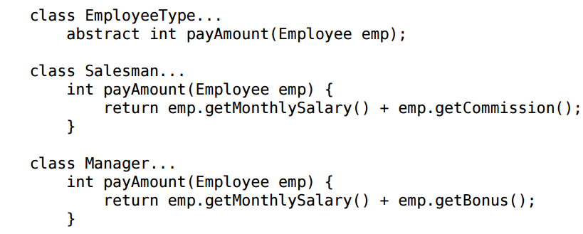
Functions
Switch Statement

Slide 25

Functions
Use Descriptive Names!
Function Arguments
// the ideal number of arguments for a function is zero
Common Monadic Forms
// if a function is going to transform its input argument,
// the transformation should appear as the return value

Slide 26
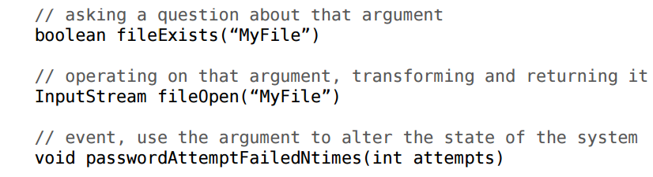

Functions
Common Monadic Form
Dyadic Functions
Notes:
Dyadic = zweiteilig

Slide 27
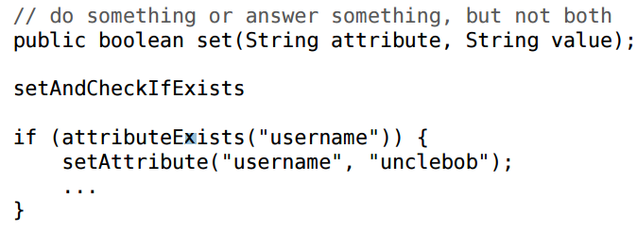
Functions
Don’t Repeat Yourself (DRY)
// duplication may be the root of all evil in software
Have No Side Effects

Slide 28
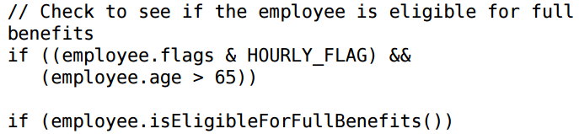

Comments (Good)
Comments do not make up for bad code
// don’t comment bad code, rewrite it!!!!
Explain Yourself in Code
Legal Comments

Slide 29


Comments (Good)
Informative Comments
Clarification
TODO Comment(s) are fine!

Slide 30
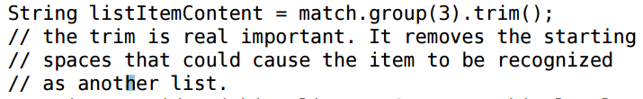
Comments (Good)
Amplification
Javadocs in Public API
// there is nothing quite so helpful and satisfying
// as a well-described public API
Notes:
Amplification = Verstärkung

Slide 31
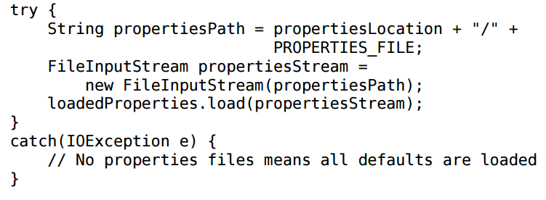
Comments (Bad)
Mumbling
Notes:
Mumbling = Gemurmel

Slide 32
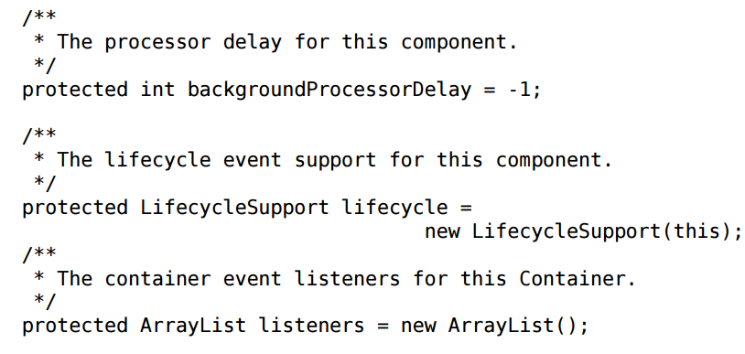
Comments (Bad)
Redundant Comments

Slide 33
Comments (Bad) – Other examples
Journal Comments
Noise Comment (Dump comments)
Scary Noise (Very dump comments)
„Don’t Use a Comment When You Can Use a Function or a Variable”
Position Markers
Commented-Out Code (!)
HTML Comment
Function Headers (short functions don’t need much description!)

Slide 34
Formatting
The Purpose of Formating
// communication
Vertical Openness Between Concept
// each blank line is a visual cue
// that identifies a new and separate concept
Team Rules
// every programmer has his own favorite formatting rules
// but if he works in a team
// then the team rules

Slide 35
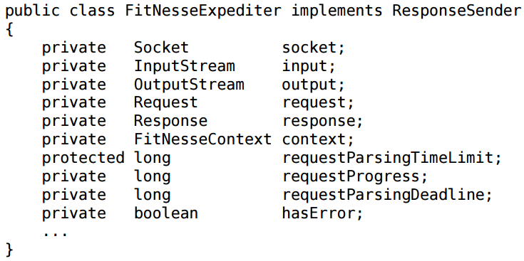
Formatting
Horizontal Alignment

Slide 36
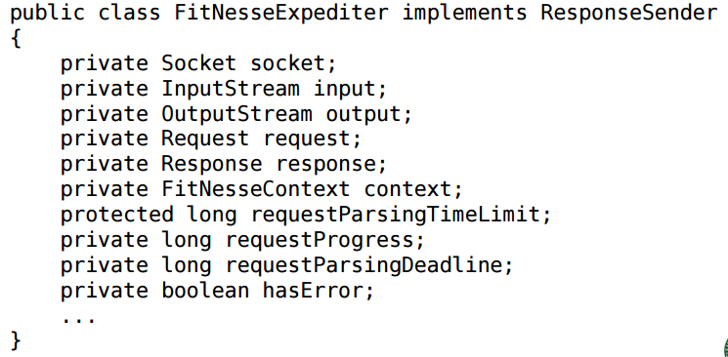
Formatting
Horizontal Alignment

Slide 37

Formatting – Other examples
Breaking Indentation
Vertical Distance
// variables
// should be declared as close to their usage as possible
// instance variables
// should be declared at the top of the class
// dependent functions
// if one function calls another, they should be vertically
// close, and the caller should be above the called

Slide 38
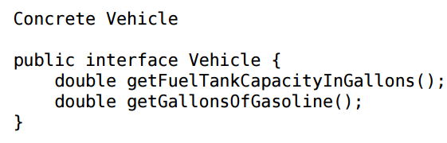
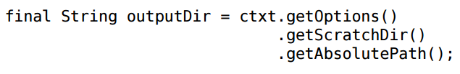
Objects and Data Structures
Data Abstraction
The Law of Demeter

Slide 39
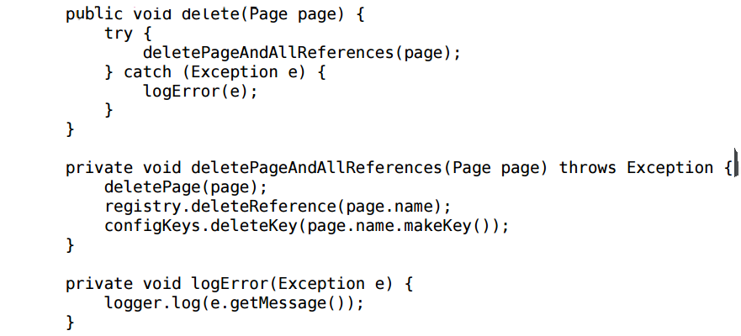
Error Handling
Prefer Exceptions to Returning Error Codes!
Extract Try/Catch Blocks

Slide 40
Error Handling – last important notes!
Error Handling Is One Thing
// functions should do one thing
// error handing is one thing
Don’t Return Null!

Slide 41
Classes
Classes Should Be Small!
// the first rule is that they should be small
// the second rule is that they should be smaller than that!
The Single Responsibility Principle (SRP)
// every module or class should have responsibility over a single part of
// the functionality provided by the software, and that responsibility should be // entirely encapsulated by the class.
Cohesion
// maintaining cohesion results in many small classes!
Notes:
Cohesion = zusammenhalt

Slide 42
Emergence
Simple Design Rule 1: Runs Al the Test
Simple Design Rules 2: No Duplication
Simple Design Rules 3: Expressive
Simple Design Rules 4: Minimal Classes and Methods
Notes:
Emergence = Entstehung

Slide 43
Sources
Robert Cecil Martin (2008): Refactoring, Patterns, Testen und Techniken für sauberen Code: Deutsche Ausgabe.
Clean Code, unter: https://de.wikipedia.org/w/index.php?title=Clean_Code&oldid=163748760 (abgerufen am 30.05.2017).

Slide 44
Any questions?

